Slide 1
Volunteer Day Date: 23rd May 2019 Theme: Member to become Volunteer

Slide 2
Agenda
•18:00 Registration and welcome
•19:00 Intro by Membership director
•19:10 Update by our President
•19:20 Award to outstanding volunteer 2018
•19:35 Deep dive existing opportunities experience
•20:30 Participants to propose/ map to current opportunities
•20:45 Roundup and closure

Slide 3
Intro Membership Director @ PMI Belgium Chapter
r
Roeland bollen
Dir. Membership PMI Belgium Chapter

Slide 4
Update by our President @ PMI Belgium Chapter
By Stéphane De Vroey
President PMI Belgium Chapter

Slide 5
3 steps of volunteering and benefits

Slide 6
Chapter Agenda 2019
Chapter Events
22/01 – General Assembly
13/03 – 2nd Chapter Event
25/04 – 3rd Chapter Event
12/06 – 4th Chapter Event
19/09 – 5th Chapter Event
04/10 – PM Fair
26/11 – 6th Chapter Event
Satellite Events
21/02 – Brussels
22/05 – Leuven
29/05 – Liège
06/06 - Brussels

Slide 7
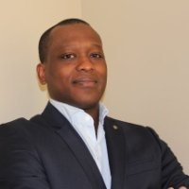
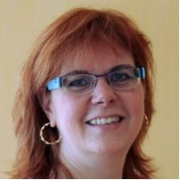
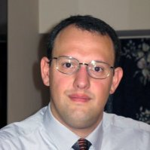
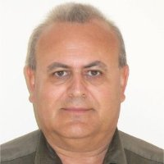
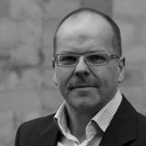
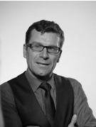
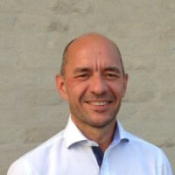
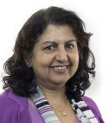
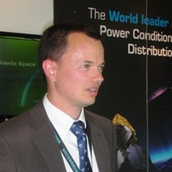
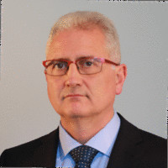
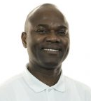
Volunteering Team 2018

Slide 8
Chapter Volunteering density

Slide 9
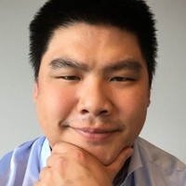
Outstanding Volunteer 2018
?
Erik Leungshun
Kumar Hiremath

Slide 10
Deep dive on the existing opportunities experience @ vrms.pmi.org – Belgium chapter

Slide 11
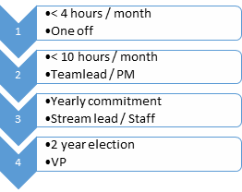
Volunteering Management Model
single ad-hoc assignments
PM of small team and Reporting
PM with L1 & L2 teams, reporting
4A Associate Director - elected
4B Director role - elected
Volunteering @ PMI Belgium Chapter

Slide 13
Deep dive existing opportunities experience
22163 Journalist
Like writing and seeking for targets to write about
Get aquainted on diverse PM related topics for getting published
Different Media channels are available
Check with Renuka

Slide 14
Deep dive existing opportunities experience
Digital Marketing Specialist
To be published

Slide 16
Deep dive existing opportunities experience
15613 Satellite Event - Leader
smaller scale event management opportunity to cover begin to the end
With support of associate director of Events – Vincent Bada
Work-out a topic to bring out for discussion before /during evening meal
Near to your home
Up to very local language / dialect speech
6 opportunities a year to become succesful

Slide 17
Deep dive existing opportunities experience
15614 Chapter Event - Facilitator
Be part of a bigger event
Diverse hands-on fun activities during the event to contribute on
At a different town/city
Skillful English language level and any other
About 6 opportunities a year to become a succesful Facilitator

Slide 18
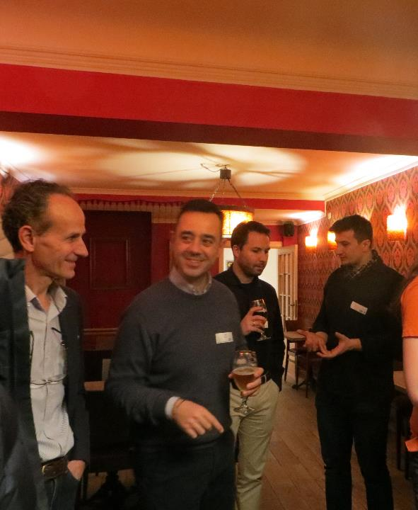
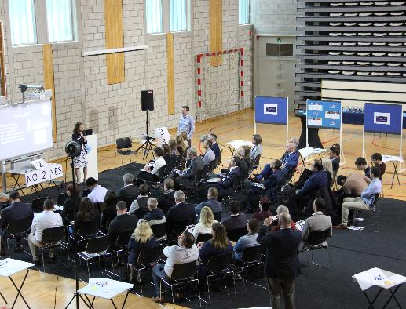
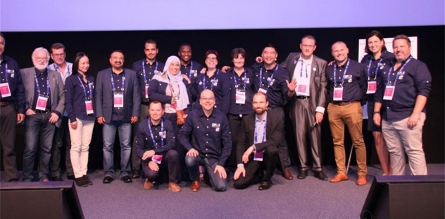

Slide 19
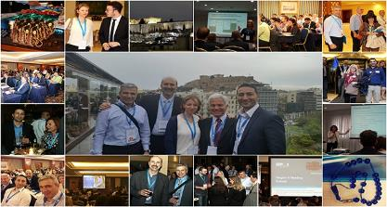

Slide 20
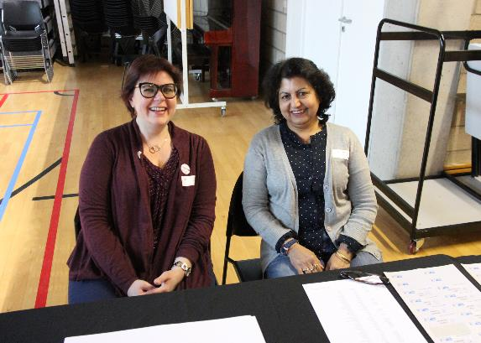

Slide 21
Embracing key milestones

Slide 22
Benefits

Slide 24
Deep dive existing opportunities experience
8657 PMI Belgium Chapter - GROW PROGRAM - Mentor
Like to enhance your mentoring skills
Under guidance of PMI guidelines and back-end support of Dir. of prof. Development (our own Frank)
Improve interpersonal and leader skills

Slide 25
Learn Thru Practice
Two Questions
BELGIUM CHAPTER

Slide 26
Learn Thru Practice
Best way to learn project management is to practice
BELGIUM CHAPTER

Slide 27
BELGIUM CHAPTER

Slide 28
What if we PMIBE could share
dream
BELGIUM CHAPTER

Slide 29
Project
Scenario
Problem
Solution
Simple PM process
Step by Step
Online Tool
1 day workshop
BELGIUM CHAPTER

Slide 30
Expected Result?
BELGIUM CHAPTER

Slide 31
Expected Result
They can
Run a simple project
Do a WBS
Define requirements
Simple online PM to support
Centralise project data
Report on status of project
BELGIUM CHAPTER

Slide 32
Learn Thru Practice
Final question
BELGIUM CHAPTER

Slide 33
Final question
Q1: How would like to learn how to give this workshop?
& change the world
BELGIUM CHAPTER

Slide 34
Deep dive existing opportunities experience
16606 TTT Trainers
Improve your lecturing skills in front of teachers
Material available
L2/L3 volunteering

Slide 35
Deep dive existing opportunities experience
16614 Creator of Educational material (courseware)
Update and actualise courseware to keep it correct and attractive for students
Prepare material in different media

Slide 36
Deep dive existing opportunities experience
15720 Project Management Trainer (French speaking)
Lecture in French to unemployed people
Translate material to French
Give trainings up to 3 time 3 h

Slide 37
Deep dive existing opportunities experience
16621 Organizer Volunteering Day - Q3 2019
Small scale event management from the beginning to the end
With support of Membership director and associate director
Work-out a theme into a small team
Get to know all chapter board members and insight of the chapter and PMI organisation
4 chances a year to become successful

Slide 38
Participants propose / map to current opportunities

Slide 39
individual discussions with the sponsors

